Slide 1
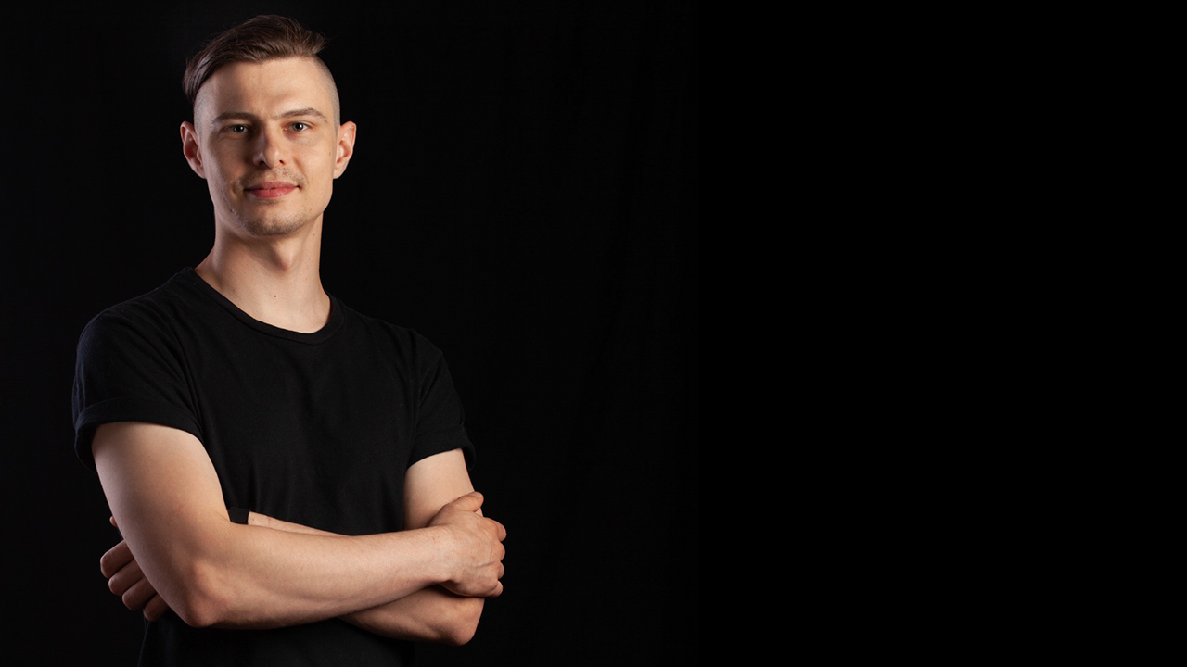
Stepan Nikulenko
Mobile Engineer
Notes:
About me

Slide 2
Me in a nutshell.
I'm passionate about technology, life, nature, and music.
My first approach to a digital world was from an early age when my father bought the first computer which I constantly broke into pieces.
After few years of assembling new computers from what I could get I started to learn networking and OS administration. Then a friend of mine told me about Macromedia Flash 4 which woke my passion for programming.
Notes:
Websites, interactive games,

Slide 3
Project types.
Retail
Customers loyalty and rewards program applications
Tourism and traveling

Slide 4
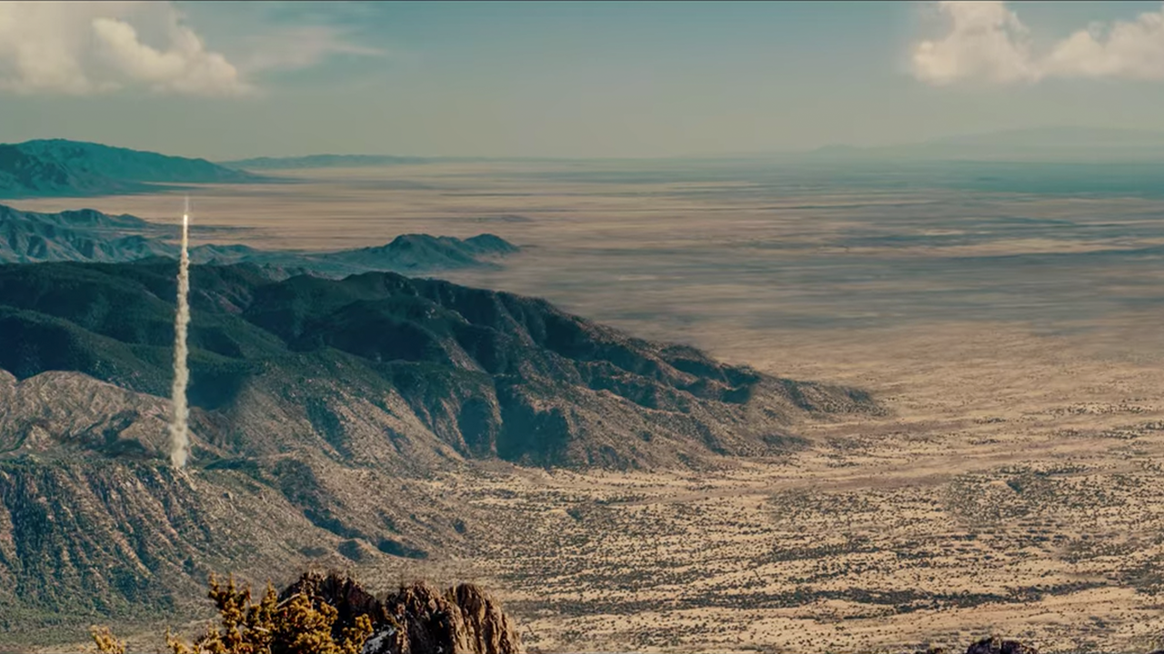
LATEST PROJECTS

Slide 5
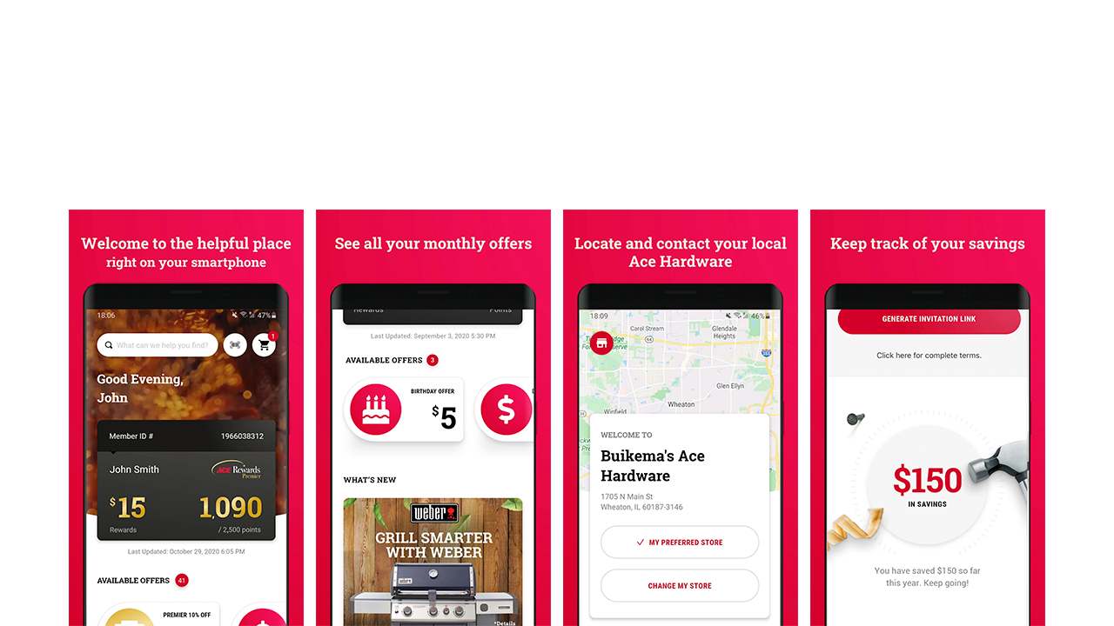
Ace Hardware rewards.
2021
Notes:
Based on RN starter project made by me in 2019
Overseeing the project
Worked on performance improvements
Better gradient solutions
Re-render profiling
Worked on analytic tracking system

Slide 6

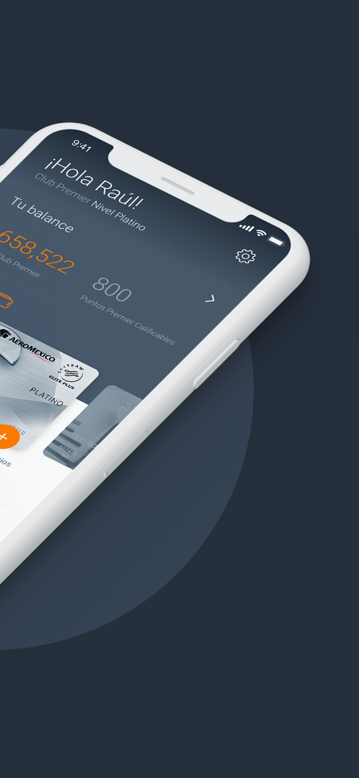
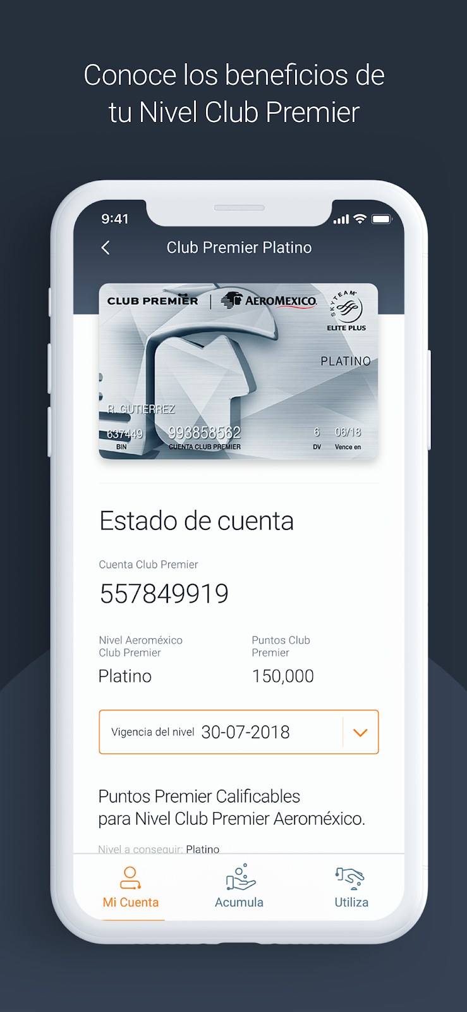
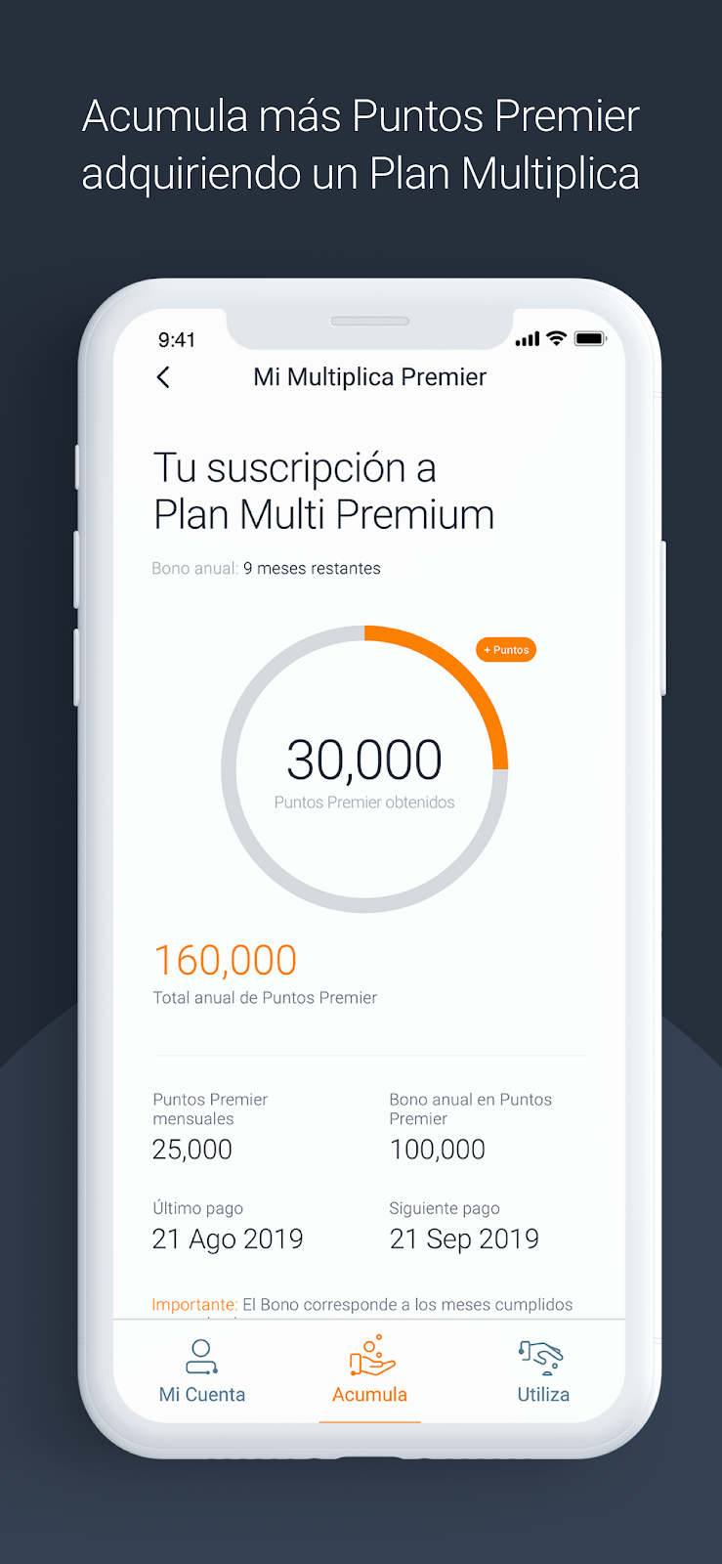

Club Premier.
2018-2021
Notes:
Native SDK implementations
LotameDMP - data tracker and analytics
SAS CI360 SDK - analytics, notifications campaigns, in-app segmented ad spots
Made RN bridge to communicate and show some UI handled by nate SDK
ThreatMetrix SDK - cybersecurity risk manager
Bitrise for Continuous Integrations
Lottie animations
Barcode scanner to scan Aeromexico tickets to fill form
Dynamic form creator based on partners requirements

Slide 7
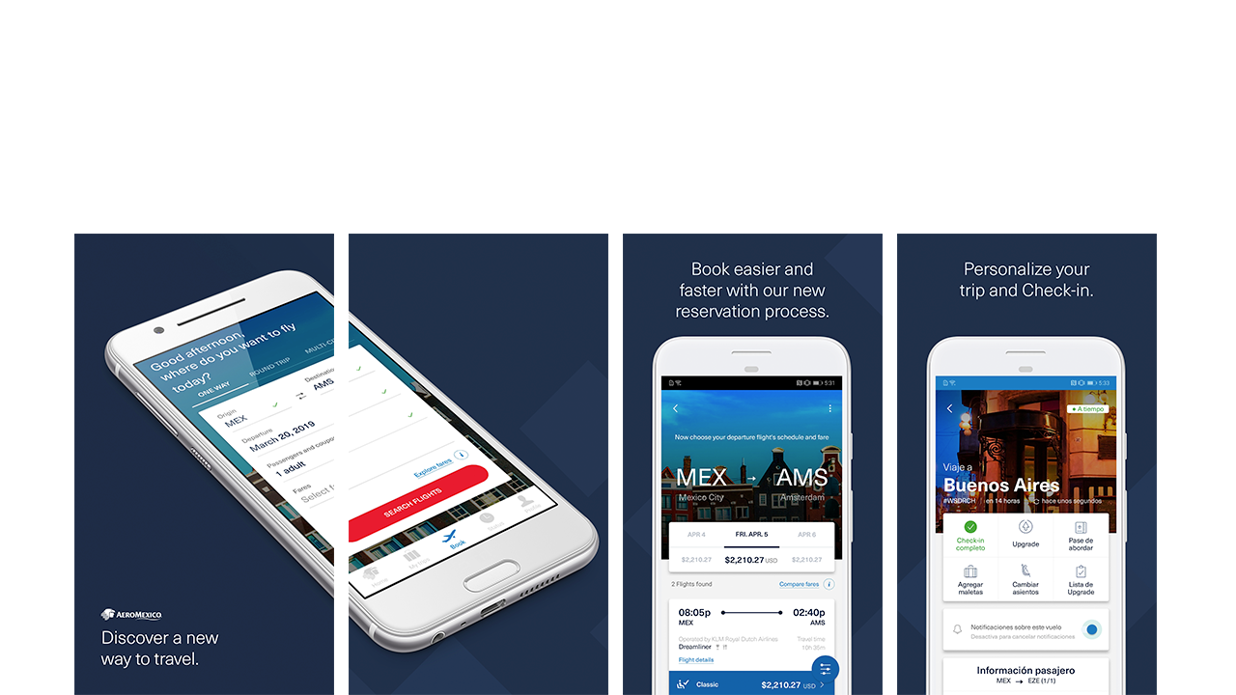
Aeromexico.
2017-2018
Notes:
Legacy code base from React web
UI animations and performance enhancement
Team of 12 developers
Sleepless nights to get to a deadline

Slide 8
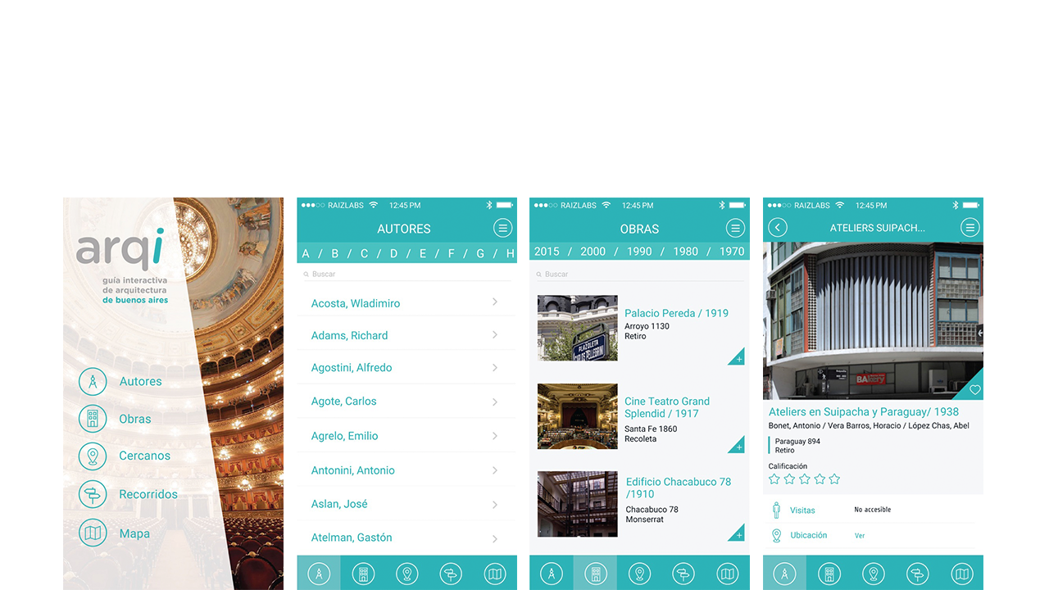
Guia Arqui Buenos Aires.
2016
Notes:
Google Maps
Custom image carousel

Slide 9
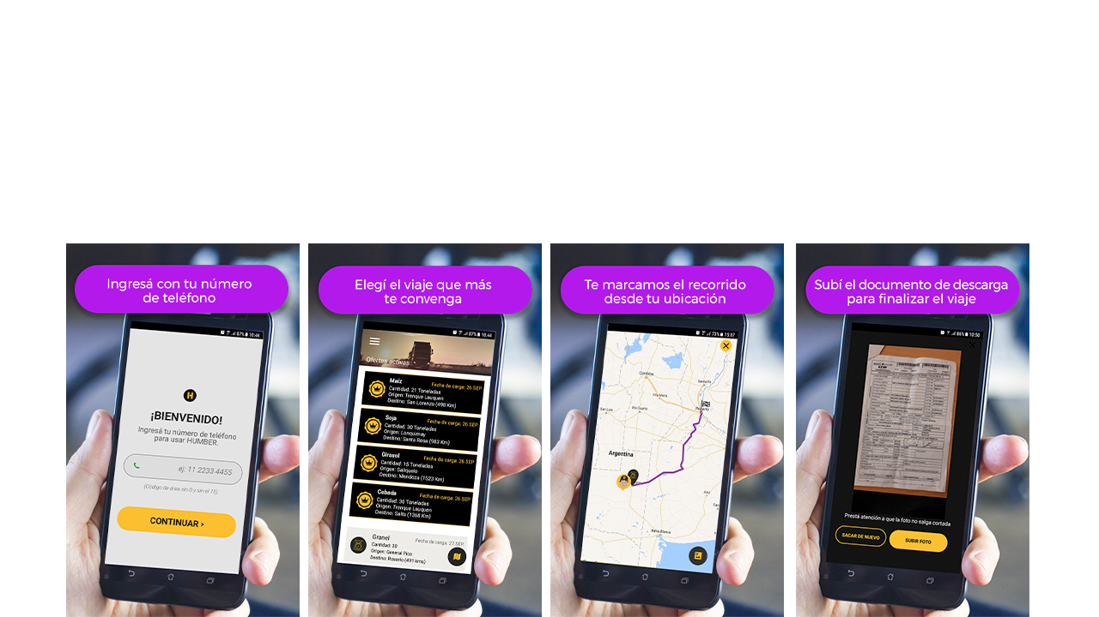
Humber.
2016-2017
Notes:
Google Maps
Successfully implemented a native SDK that enables precise user tracking through GSM network technology.
This application is designed to assist track drivers in finding suitable merchants for transportation between destinations, complete with tracking capabilities and additional benefits.

Slide 10
OTHER PROJECTS

